Slide 1

Data Driven Education
Discussion Forum Subteam
Presentation 2 - 10/26/2022
Notes:
Pratik

Slide 2






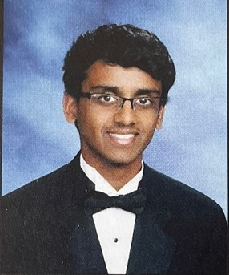
Team Members
Malav Patel
Data Scientist
Hyun Soo Kim
Data Scientist
Jisan Park
Data Scientist
Pratik Agarwal
Project Manager
Ankit Mishra
Front-end
Web Developer
Gautam Sugasi
Back-end
Developer
Ritika Gehani
Front-end
Web Developer
Notes:
All

Slide 3


Background context
Discussion forums
  Online formats - primary source of interaction
Student interaction
  Cognitive presence
  Sentiment Analysis
Activity on forums indicative of student engagement and interest
Goal: Creating a web application to help instructors save time on managing forums and increase cognitive engagement in their courses
Notes:
Pratik
Our focus for this semester is to create an MVP dashboard where instructors can get actionable insights on different aspects of their courses like difficulty of content, student sentiment on different topics covered in material and so on. We’re using data from Dr. Thad Starner’s online course on Artificial Intelligence. In addition, we’re using the community of inquiry framework to analyse the engagement level in the course using cognitive presence analysis, however that’s a small component of our work this semester.

Slide 4
Progress till now
Category | Accomplished | Next Goals
Web Dev | Grids and frames for the dashboard partially ready | Incorporate graphs generated from Piazza data
UX Research | This bit will start after dashboard is ready | Evaluation through interviews with instructor
Data Science | Topic model Aspect-based sentiment analysis model | Incorporate with dashboard and improve existing models
Learnings and Challenges as a Project Manager:
Having clear actionable deliverables for each week aids progress
Focus on end-to-end integration helps in iterating on individual pieces later
Encourage sub-teams to work together in coordination with each other and allow chances for team members to take lead on different things
Notes:
Pratik:

Slide 5
Goals for this semester
Development
  Deploy the web-app and test inside the Piazza sandbox environment
Research
  Prepare questionnaire for evaluation with instructors
Project Management
  Have a documentation for the project to help future teams not having to reinvent the wheel
Notes:
Pratik:

Slide 6
Data Science
Notes:
Malav

Slide 7
Research Goal
Based on the community of inquiry framework, what are some key factors in discussion forum activities influencing student engagement and performance in an asynchronous online classroom?
How can we design a web app that can provide actionable insights to the instructor in order to increase engagement and performance?
Notes:
Malav
Our goal is to analyze student interaction with their peers and understand their engagement and performance in a classroom. One way this can be achieved is by creating a dashboard that could provide visuals about the sentiments and topic analysis from their interactions within the online learning community. Our team’s main goal for this semester is to deploy a functioning dashboard that could provide more valuable feedbacks to the professors and can help them structure their courses in the future.

Slide 8
Data Science Big Picture
Data available
  Focusing on Piazza data from Dr. Thad Starner
  1493 posts, coded for cognitive presence and working on Topic Modeling
Cognitive Presence
Metacognition
Data Science
Topic Modeling
Aspect-Based Sentiment Analysis
Notes:
Malav
Our team is working and has worked on multiple topics to provide valuable insights to the professor. We are using the data from Dr. Thad’s course. Now we’ll be going over our end goals for the semester and our progress for each of them. I’ll pass on to Harriet to explain

Slide 9
End Goals for the semester
Work as a backend and process Piazza data
  Cognitive Presence Modeling (Already performed in Spring 2020)
  Topic Modeling (Used LDA+Bert last semester, Experimenting with NMF)
  Aspect Based Sentiment Analysis
Output these results on the dashboard for the professors to get a meaningful insight
  Create a pipeline
  Write a Python script that runs the Piazza data in real-time on the above models.
Piazza feature that would match piazza posts in real-time and provide TAs a list of responses to choose from.
  Creating a list of topics and matching the top responses for the real-time data.
  Separate Q/A
  Write a Python Script to automate this process
Notes:
Harriet

Slide 10
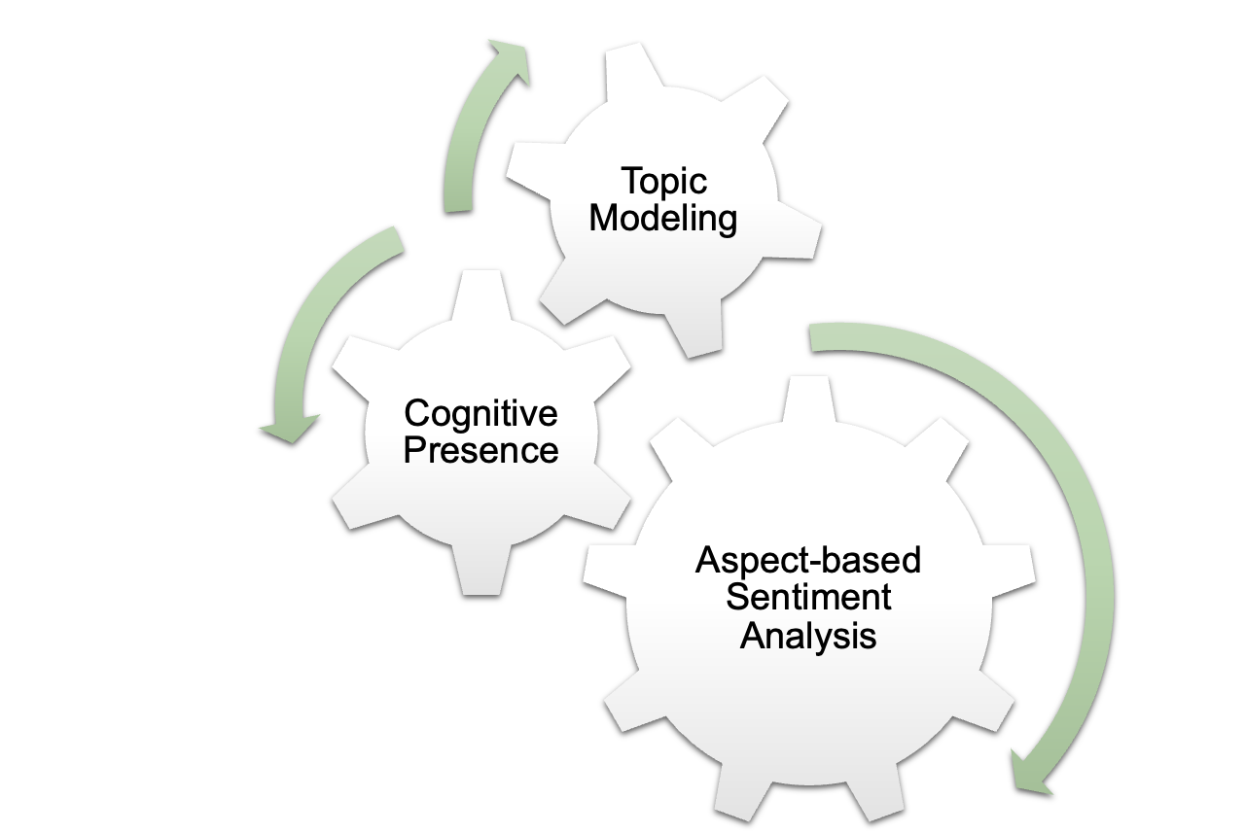



Data Science
Notes:
Harriet

Slide 11
Cognitive Presence and Topic Modeling
Why Cognitive Presence modeling?
It is an important indicator of quality of an online learning experience
How well a student is performing in the online course based on his/her comment in Piazza
Why Topic modeling?
Gives insights on which topics students are discussing the most on Piazza
  confusing questions > feedback for the lecture > better education
Potentially matching similar or repeated questions for corresponding topic score distribution (for the future work)
Notes:
Harriet
since it consists of authentic approaches based on collaboratively constructing knowledge in an online environment

Slide 12

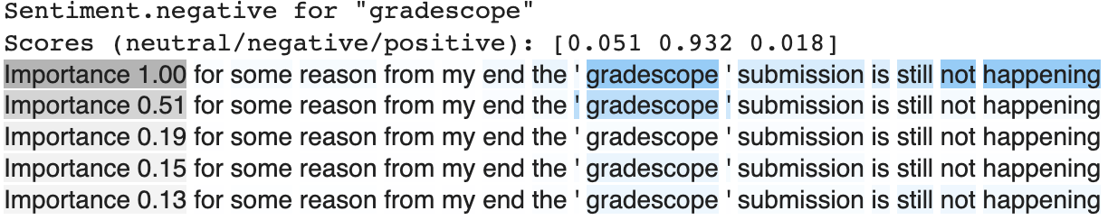
Aspect-based Sentiment Analysis
A machine learning task that identifies and assigns sentiment to aspects, features, and topics that it has categorized in the body of data
Example
Text: for some reason from my end the ' gradescope ' submission is still not happening
Aspects: [test, project, quiz, homework, gradescope, assignment]
Output: neutral: 0.051, negative: 0.932, positive: 0.018 for ‘gradescope’ aspect
Why ABSA?
Using this modeling we can provide reasonable sentiment for aspects
  student’s current circumstance for multiple aspects at once
For future, output from topic modeling > aspects in ABSA
Notes:
Jisan
Aspect-based Sentiment Analaysis is a Machine Learning to identify and assign sentiment to aspects. In this model, we have to select multiple aspects. We considered that aspects can be test project quiz homework gradescope assignment for the first demo so that we can see students’ sentiment to class system. for example, if a text is like the example text, the sentiment is negative. Then, We could guess something wrong in gradescope, here is submission error. Basically it can describe the students’ current circumstance for multiple aspects at a time. Also I think for the future work we would like to change the aspects based on the output of the topic modeling so that we expect to display the sentiment for lecture content. This could be other option.
Aspect-based sentiment analysis is what we brought out this semester. It is a machine learning task that identifies and assigns sentiment to aspects, features, and topics that it has categorized in the body of data. It receives texts and aspects as inputs and returns the ratio on how positive, neutral, and negative they are. It is mostly used on evaluating reviews such as movie or restaurant review, but we are applying it on Piazza data.
The example you can see on the screen is one of the posts on Piazza for an AI class. It says that “I am not sure why the link is not active”, and when we put link as an aspect, then we can see that the output says negative, because the keyword “link” is being evaluated as negative.
We are planning on using our keywords from topic modeling as aspects, and we expect this to help collect students' opinions and evaluations on difficulty or teaching methods in respect of specific topics.

Slide 13
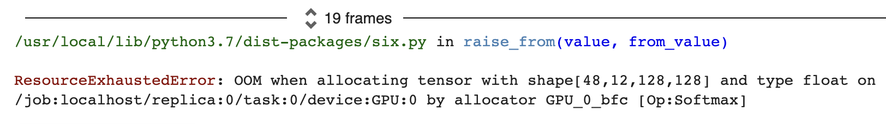
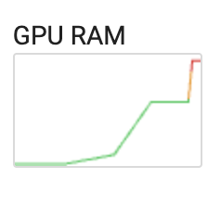
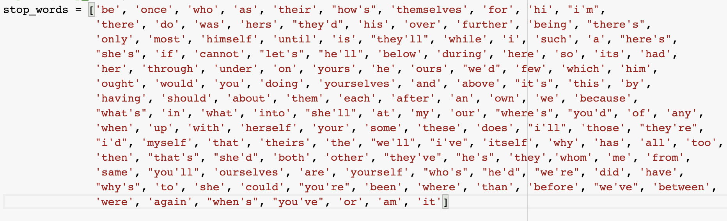
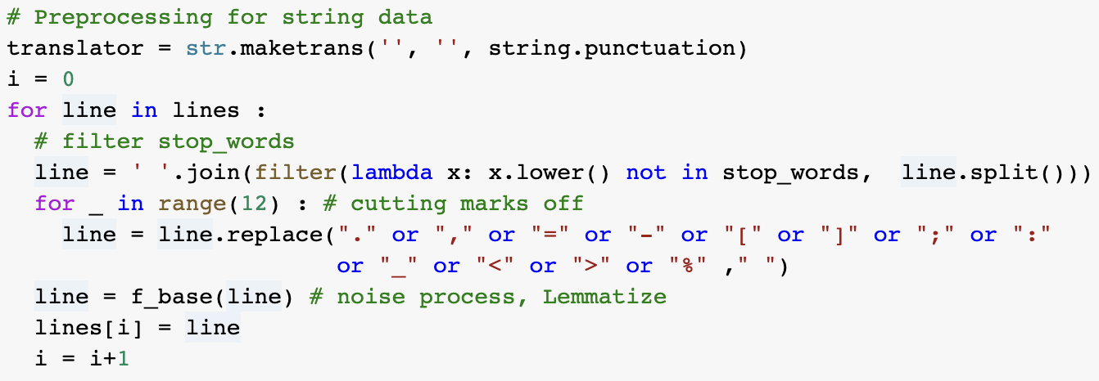
Challenges
For ABSA, pre-processing and training is making GPU out of memory
  Tried pre-processing it by removing unnecessary words like I, we, etc.
  Worked, but had to request for a larger GPU RAM
The topics we need to pick. For now we have chosen the common topics, we can choose topics from Topic Modeling.
Notes:
Jisan
Our ultimate goal for this semester is to improve all topic modeling, cognitive presence, and aspect-based sentiment analysis and to actually build a pipeline from data science model to our web page dashboard. We are planning to generate our result as a .csv file to deliver our output to web-dev team.

Slide 14
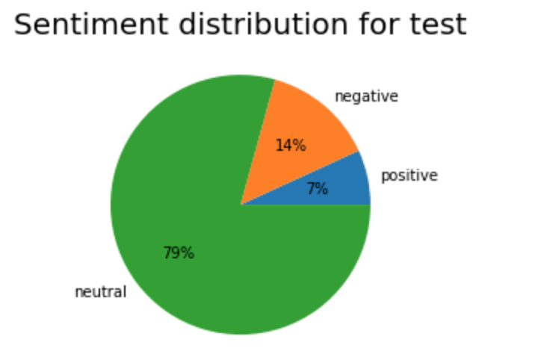
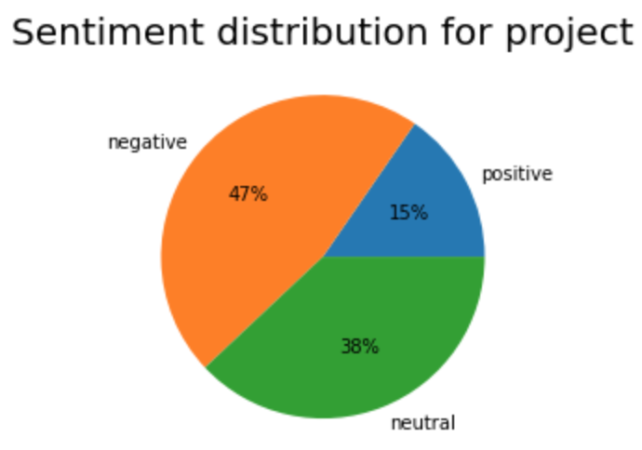
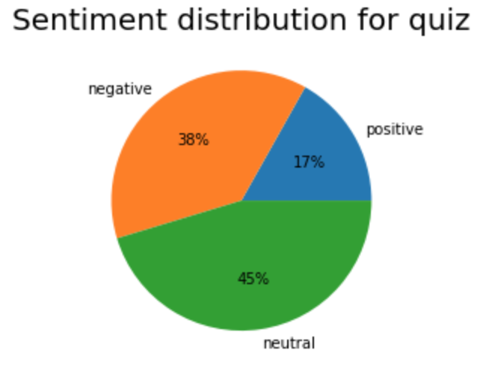
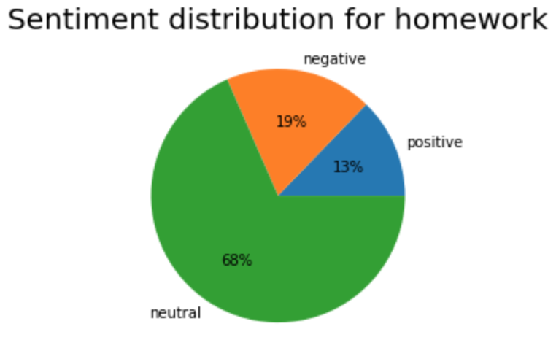
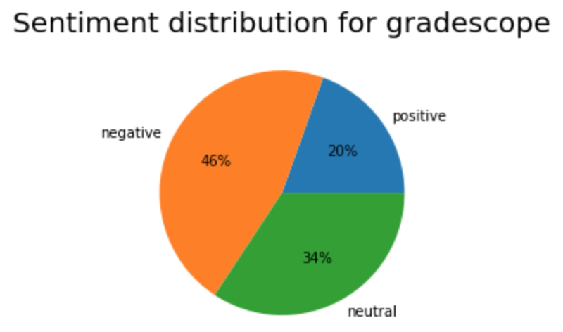
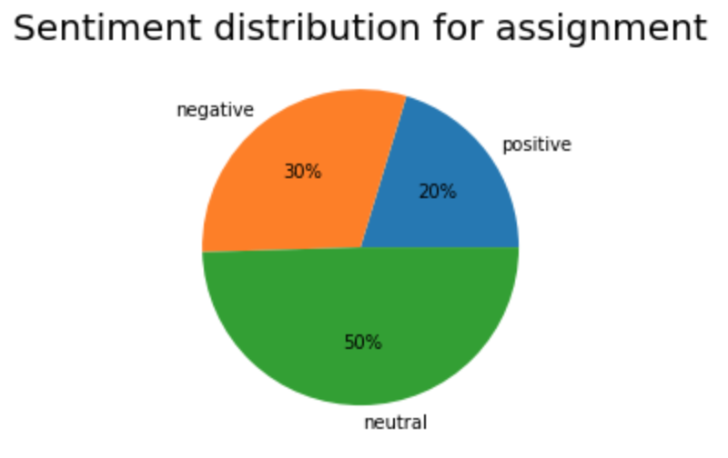
Results from ABSA
Notes:
Jisan

Slide 15
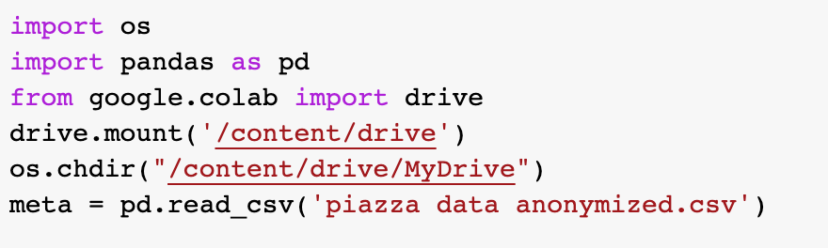
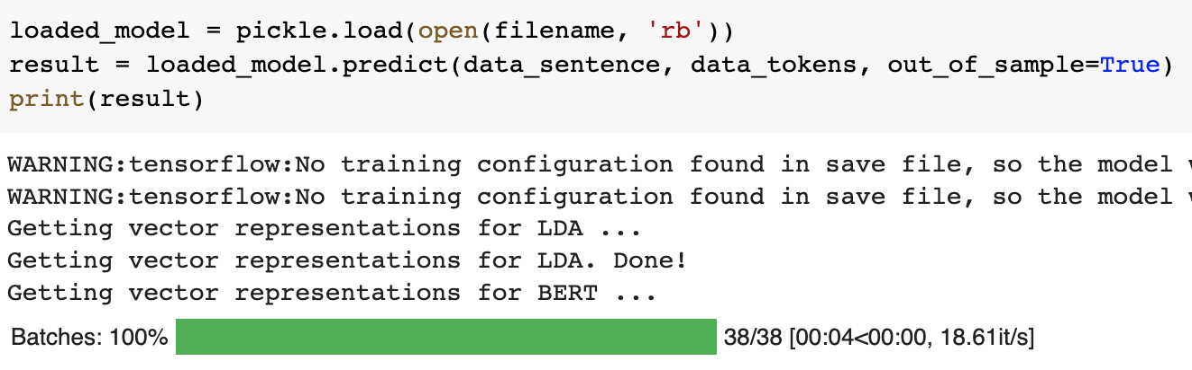
Python Script
Challenges
No new Piazza data available to test our saved models
  We’re splitting the existing data into 80:20.
Were facing issues running SQL script and connect the database
Notes:
Malav
We have started our work on the Python script. We were able to run the test data on the saved models (Cogitive Presence and Topic Modelling), and now our next step would be merge in the ABSA modeling as well. For now, the script is just generating textual data for individual models and not storing any visuals in our system. But, the next step would be to store visuals and provide them to the web-dev team. Since we don’t have new data, we had to split the dataset into 80:20. But, once we deploy it and the database is updated, we will be fetching the data using a SQL query and lay a foundation for the back-end.

Slide 16
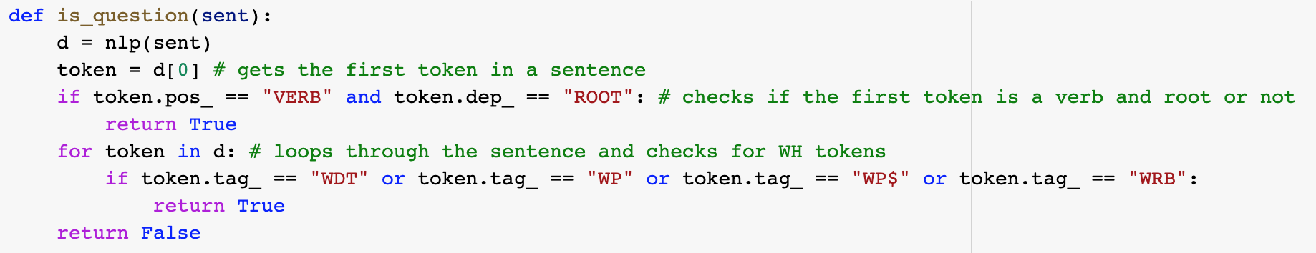
Piazza Feature
Couldn’t find any pre-trained models to separate Q/A.
Used token matching to separate the list.
Split the answers_data in 80:20 (train:test) and ran topic modeling.
Next Steps:
Get a topic distribution on the 20% answers dataset
Create a python script to automate the process
Notes:
Malav
We have started our work on the Piazza feature that we will be prototyping by the end of this semester. For now, we are using token matching to separate the questions and answers, but it’s not quite accurate. We are constantly researching about a better model for this. Also, we have started working on the python script and the next step in our process would be to run the 20% data on the saved model, and get a list of topics. Then we’ll be matching these topics with our database with the similar topics and would list out the results. Being a TA, I think that this feature will help answer a lot of repetitive questions about both the logistics and content that could have been answered in the previous semesters.

Slide 17
Web Development

Slide 18
End of Semester Goals
Create the dashboard
React.js technologies to create frontend dashboard
  Use Figma mockups from previous semesters as a design guideline for what is expected
Connect frontend with backend so database data can be updated in real time
Notes:
Gautam

Slide 19
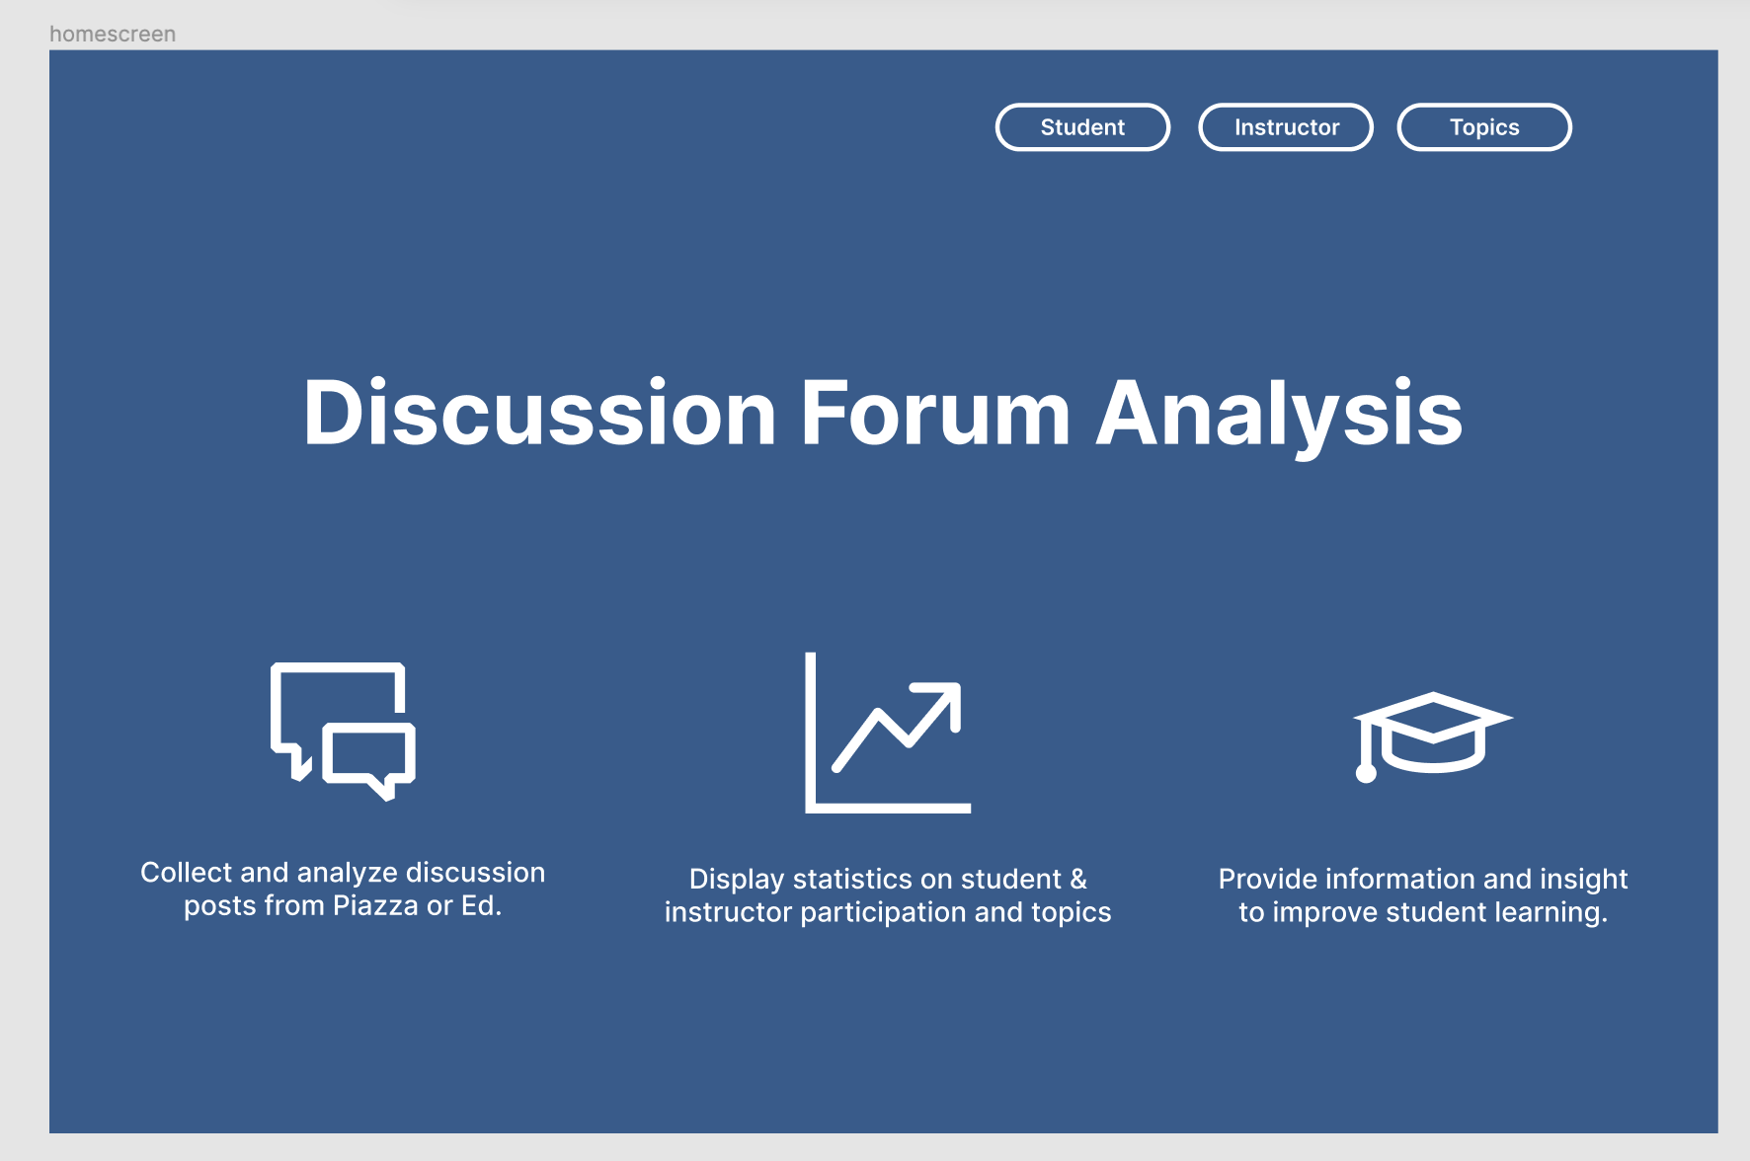


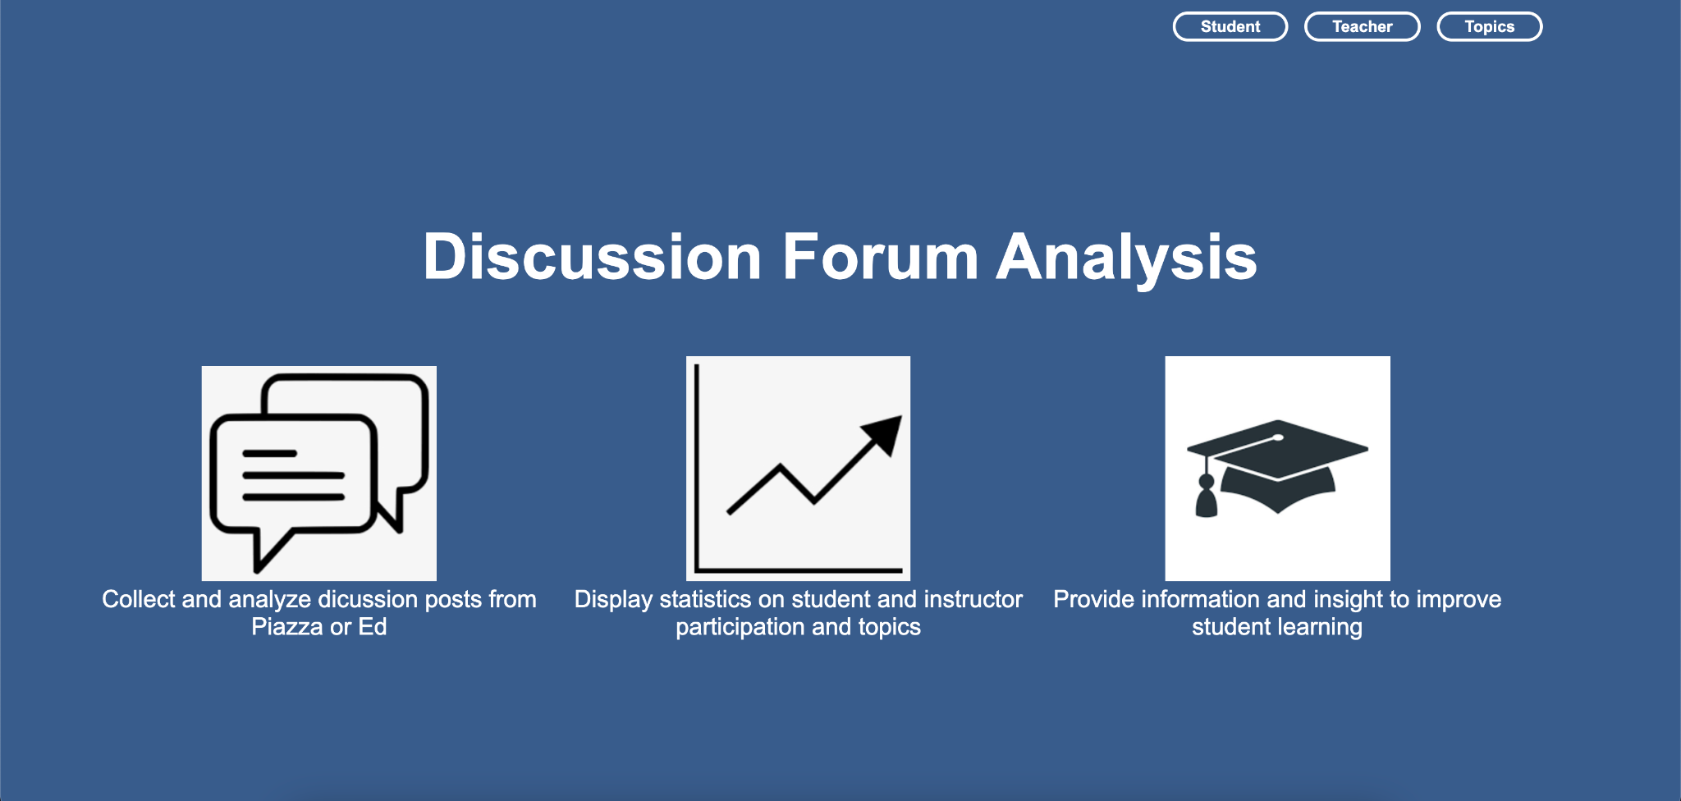


Notes:
Gautam

Slide 20
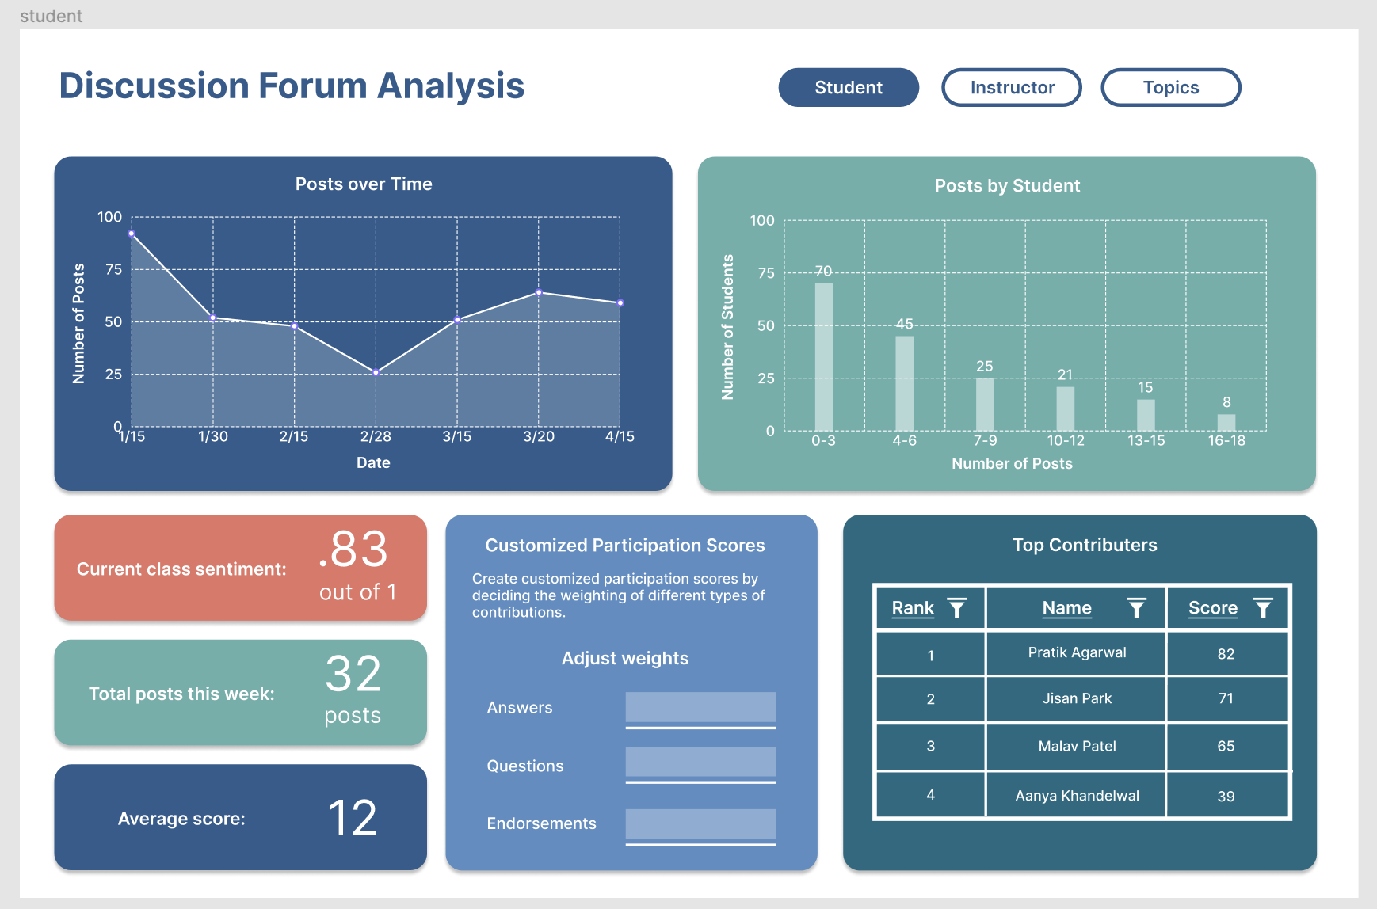
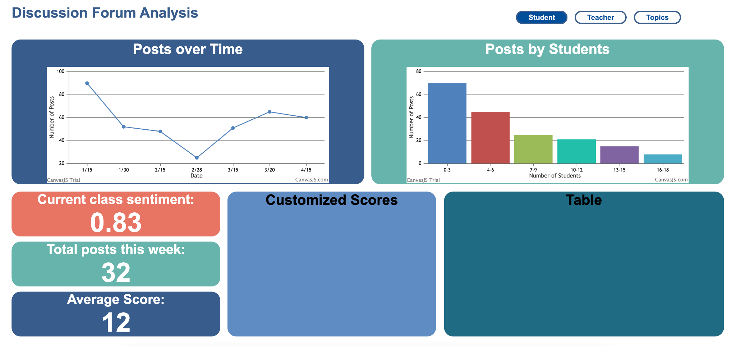
Notes:
Gautam

Slide 21
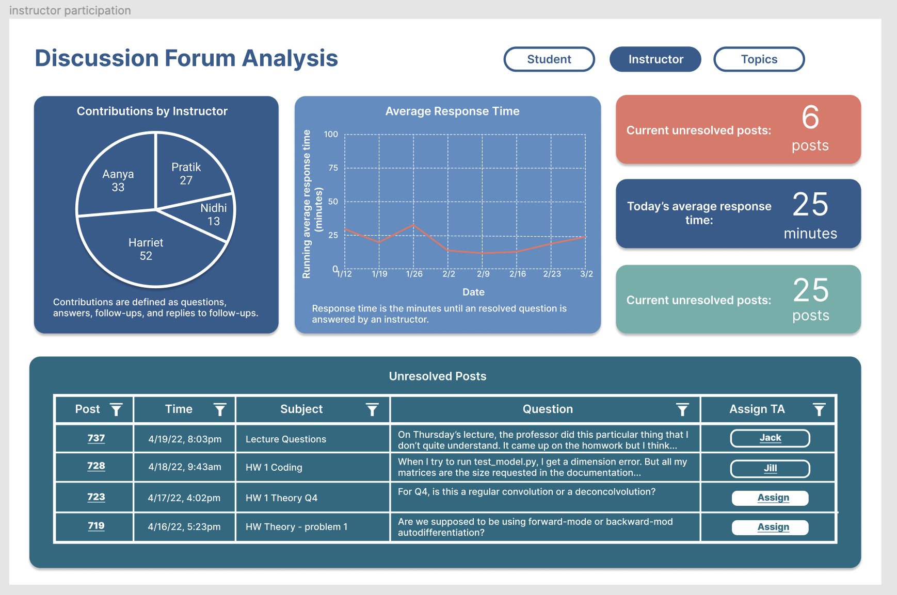
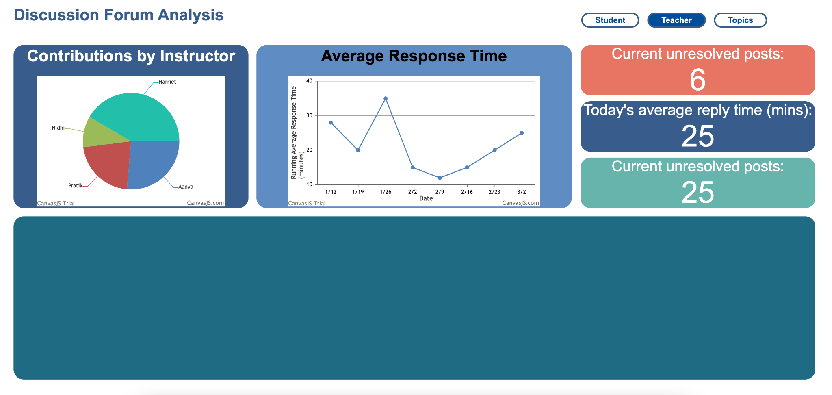
Notes:
Ankit

Slide 22
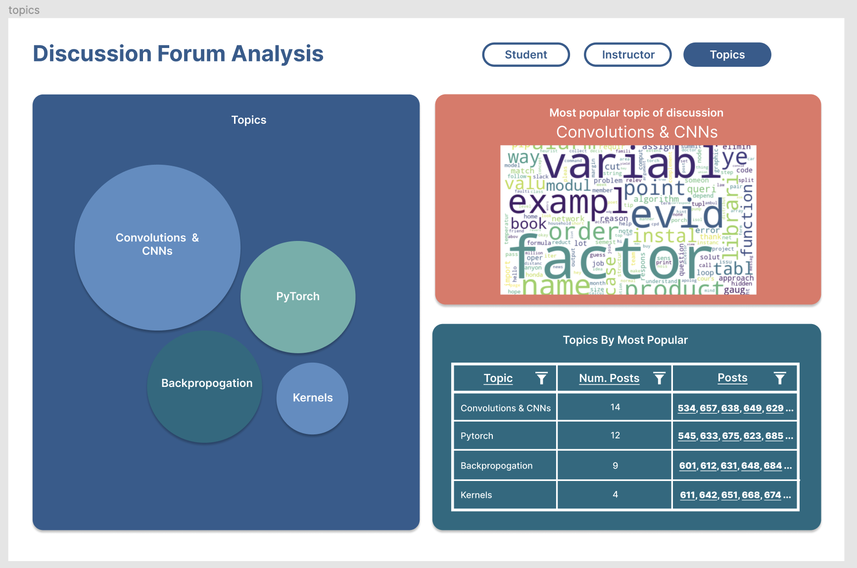
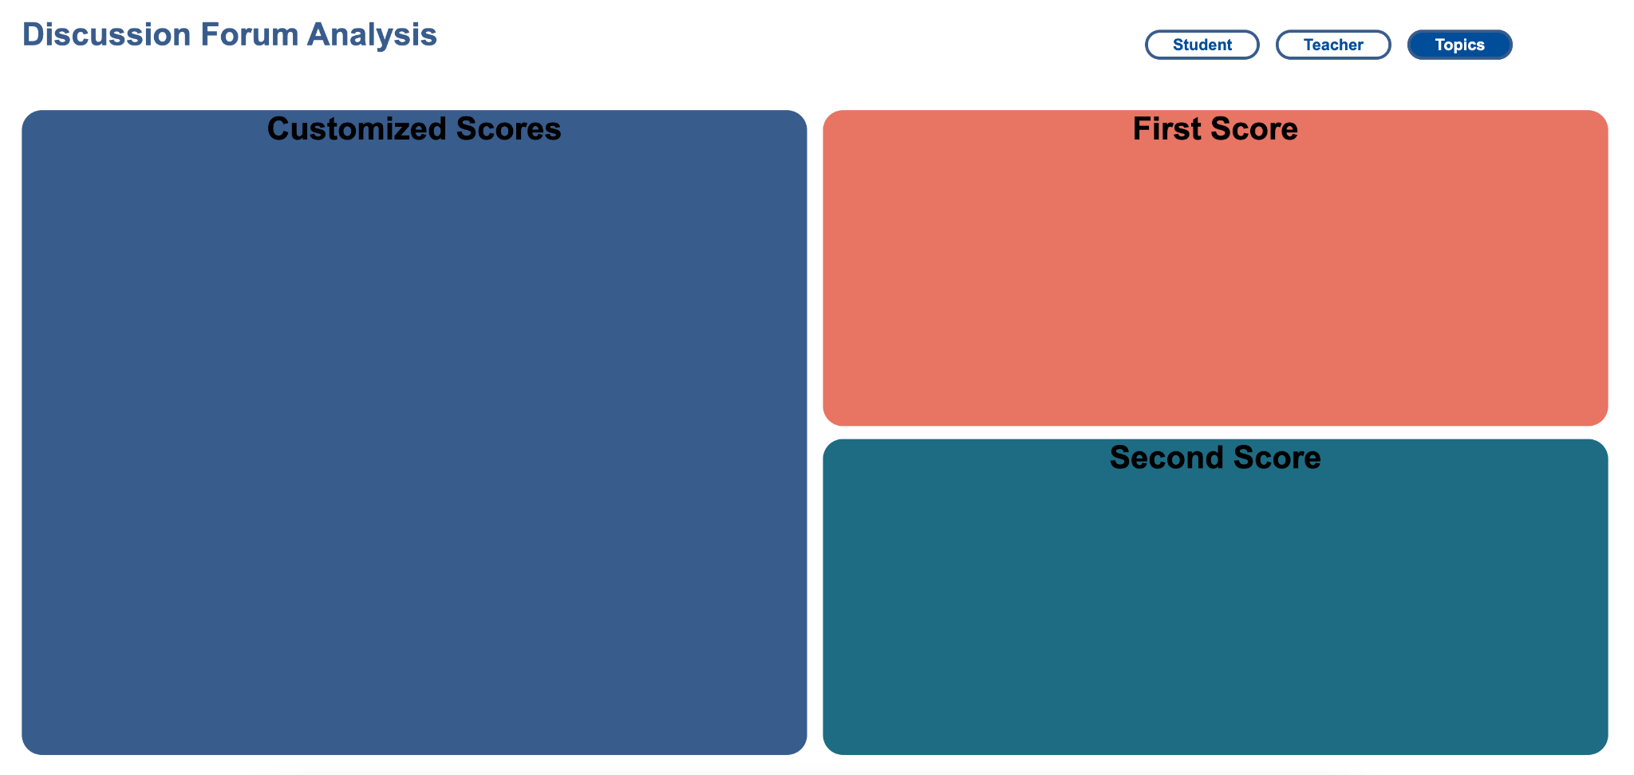
Notes:
Ankit

Slide 23
Challenges
Need of Documentation
  Difficult to immediately start the project since we had to start from scratch, pushing back all of the tasks we wanted to complete
  To fix this, we are creating documentation so members next semester are able to understand everything
Creating Dynamic Table
  Wanted to create a dynamic table changing the data as new realtime Piazza conversations are received
  Currently have created a static table in HTML
  Researching frameworks that work with React
Notes:
Ritika:
One challenge we faced was first realizing how difficult it was to start the project immediately because we were given no documentation so we essentially had to start from scratch, which pushed back some tasks for the semester. To avoid this issue again, we are going to create documentation so that the members next semester are able to understand everything
Another challenge we faced is trying to create a dynamic visual table that changes as the data changes with the realtime Piazza conversations. We currently have a static table in HTML, but have been looking into different frameworks and found a framework called AG Grid, so this is something that we will potentially learn and implement since it works well with React components and when the data is changed.

Slide 24
Conclusion
Project Roadmap
  Deployment of web-app and testing in Piazza sandbox environment and user feedback from instructor team
Model Development
  Aspect-Based Sentiment Analysis to help instructors get actionable insights on different aspects of their courses - assignments, instructor team, course materials, grading etc.
Piazza Feature
  Allow TAs to respond to an incoming question from the top matched responses from previous semester’s data using topic modeling
Notes:
Pratik
To conclude, the next steps in the roadmap is getting the web-app deployed, and on the data science end, use aspect-based sentiment analysis to help instructors understand the discussion forum activity in a more granular fashion and get actionable insights based on “how are the students feeling about different aspects of the course”, like assignment quality, course materials, response time of instructors etc for example. Also if we get time, we want to continue using the topic modeling to provide a feature in Piazza that could suggest responses to the incoming questions based on the previous years data collected. Not all of this can be done in this semester but we’re trying to move towards it and create documentation for future team to take it from here.

Slide 25
Citations
Garrison, D. R., Anderson, T., & Archer, W. (1999). Critical Inquiry in a Text-Based Environment: Computer Conferencing in Higher Education. The Internet and Higher Education, 2(2–3), 87–105. https://doi.org/10.1016/S1096-7516(00)00016-6
Garrison, D. R., Anderson, T., & Archer, W. (2001). Critical thinking, cognitive presence, and computer conferencing in distance education. American Journal of Distance Education, 15(1), 7–23. https://doi.org/10.1080/08923640109527071
Devlin, J., Chang, M. W., Lee, K., & Toutanova, K. (2018). Bert: Pre-training of deep bidirectional transformers for language understanding. arXiv preprint arXiv:1810.04805.
Medhat, Walaa, Hassan, Ahmed, Hoda, Korashy (2014). Sentiment analysis algorithms and applications: A survey. Ain Sham Engineering Journals. https://doi.org/10.1016/j.asej.2014.04.011
MacMillan, Kelsey, and James D. Wilson. Topic Supervised Non-Negative Matrix Factorization, Arxiv, 4 July 2017, https://arxiv.org/pdf/1706.05084.pdf.
Beri, Aditya. “Latent Dirichlet Allocation.” Latent Dirichlet Allocation, CodeChef-VIT, 27 Jan. 2021, https://medium.com/codechef-vit/latent-dirichlet-allocation-812bb8099518.
Rolczyński, Rafał. Do You Trust in Aspect-Based Sentiment Analysis? - SCALAC, https://scalac.io/wp-content/uploads/2021/04/Ebook_Explainable-Sentiment-Analysis.pdf.

Slide 26
Questions?

Slide 27

Community of Inquiry
“a group of individuals who collaboratively engage in purposeful critical discourse and reflection to construct personal meaning and confirm mutual understanding”
Elements of an Educational Experience (Garrison et al., 1999)

